Slide 1
Inference on Proportions One Sample Proportion – Confidence Intervals and Hypothesis Tests
Estimation and Hypothesis Testing

Slide 2
Sampling Distribution of a Proportion
Draw a random sample of size n from a population having population proportion p of successes.
Let X be the count of successes in the sample and = x/n.
When n is large, the sampling distribution of is approximately normal:

Slide 3
Structure of a Confidence Interval
In words:
estimate + (critical value) x (standard deviation of the sampling distribution)
Formula
Any issues?

Slide 4
Confidence Interval for p
Replace the p’s with in the formula
New CI Formula
Use this interval only when the number of successes and failures in the sample are both at least 15.
Standard Error

Slide 5
Examples

Slide 6
Minimum Required Sample Size
Where
m is margin of error
n is sample size
is sample proportion
z* standard normal value from Table A
p is either a sample proportion or the conservative 0.50

Slide 7
Example

Slide 8
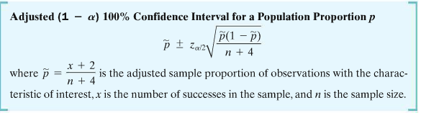
Unless n is large, this previous method performs poorly when p is close to 0 and 1 Suggest using the adjustment below to construct a better estimate interval

Slide 9
Example
For a class project, a student randomly sampled 20 fellow students at the University of Florida to estimate the proportion at the university who were vegetarians. Of the 20 students she sampled, none were vegetarians.
Let p denote the population proportion of vegetarians
p-hat, the sample proportion, = 0/20 or 0
When p-hat = 0 then the se = 0

Slide 10
If she used the first formula, , she would conclude
that the 95% confidence interval her would be (0,0). However, she realized that her sample did not meet the assumptions necessary to use the formula as n(p-hat) = 20 *0 >15 so she used the adjustment
Now her confidence interval becomes
So she can be 95% confident that the proportion of vegetarians at University of Florida is no more than 19%

Slide 11
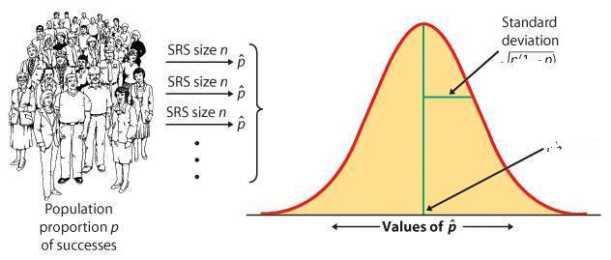
Hypothesis Testing – proportions – large sample
If H₀ is true, the sampling distribution is known
The likelihood of our sample proportion given the null hypothesis depends on how far from p₀ our is in units of standard deviation.

Slide 12
General Hypothesis Testing Procedures
Step 1:
Ho: p = vs H_{a}: p < or > or ≠
Direction of Ha depends on the question
Step 2: Collect data
Step 3: Check assumptions for large sample inference.
1. Individuals are independent
2. Sample is sufficiently large - check this by determining if n(p-hat)>15 and n(1-p-hat) >15

Slide 13
Step 4: Calculate the test statistic
Step 5: Use the test statistic to determine the p-value and make a decision regarding the null hypothesis.

Slide 14
Example
In a 2006 Florida poll a random sample of 1200 Floridians showed that 52% preferred to raise taxes while 48% preferred to reduce services
Let p denote the population proportion in Florida who would choose raising taxes over reducing services
A political needs to know if more than 50% of all Floridians preferred raising taxes so they conduct a hypothesis test

Slide 15
Hypothesis Steps
Ho: p =0.50
Ha: p > 0.50
Where p is population proportion in Florida who would choose raising taxes over cutting services.
Assume they collected a random sample and this is a large random sample

Slide 16
Test statistic =
P-value = P(Z>1.39) = 0.0823
As the p-value is greater than a 0.05 level of significance, there is no evidence that the proportions of Floridians who prefer to raise taxes is more than 50%.

Slide 17
Inferences for Two Population Proportions
Now consider inferential procedures concerning a comparison between the rates of incidence of a certain characteristic in two populations.

Slide 18
Population 1
Population 2
Prop’ n = p₁
Prop’n = p₂
Sample 1
Sample 2
Prop’n =
Prop’n =

Slide 19
Theorem
For large independent samples of sizes n₁ and n₂ from two populations, the distribution of the differences between sample proportions ( )is approximately Normally distributed with mean (p₁ – p₂) and standard deviation

Slide 20
It therefore follows that:
is N(0,1) [Standard Normal]

Slide 21
Testing the Difference Between Two Proportions
We test H₀: p₁ = p₂
If this is true, then (p₁ – p₂) = 0
If p denotes the common value of p₁ and p₂ then our standard normal variable becomes:

Slide 22
Z =

Slide 23
The unknown parameter p must now be estimated by pooling information from the two samples to obtain the proportion of the attribute in both samples combined.
If x₁ and x₂ denote the number of members sampled that have the attribute, then we estimate p by:

Slide 24
Hence, if H₀ is true, the test statistic becomes:
Z =
This test is based on the Standard Normal Distribution.

Slide 25
Example
A large automobile-insurance company selected samples of single and married male policyholders and recorded the number who had made an insurance claim over the previous 3-year period.
The following data was obtained:

Slide 26
Single Married
Policyholders Policyholders
n₁ = 400 n₂ = 900
Number making Number making
Claims = 76 Claims = 90
Using α = 0.05 test to determine if claim rates differ between the populations of single and married male policyholders.

Slide 27
Solution
Let “1” = single, “2” = married
H₀: p₁ = p₂ H_{a}: p₁ ≠ p₂
= 76/400 = 0.19
= 90/900 = 0.10
= (76 + 90)/(400 + 900) = 0.1277

Slide 28
Test statistic is:
Z =

Slide 29
Z = 0.09/0.020 = 4.5
From z-tables, CV = ± 1.96 for a two-tailed test at α = 0.05
Hence we have evidence to reject H₀
We do have evidence of a difference in claim rates between single and married males.

Slide 30
Confidence Intervals For The Difference Between Two Population Proportions
A CI for (p₁ – p₂) is given by:

Slide 31
Example
A 95% CI for the difference between the proportions of single and married male claim-making policyholders is:

Slide 32
CI = 0.09 ± (1.96)(0.022)
= 0.09 ± 0.043
= (0.047, 0.133)
= (4.7%, 13.3%)
Note that this CI does not contain zero.
It supports the (significant) hypothesis test.

Slide 33
Accurate Confidence Intervals for Comparing Proportions, Plus-4 Method
Choose independent SRSs from two large populations with proportions p₁ p₂ of successes. To get the plus-four confidence interval for p₁ – p₂, add four imaginary observations, one success and one failure, in each of the two samples. Then use the large-sample confidence interval with the new sample sizes (actual sample sizes + 2) and number of successes (actual number + 1).
Use this interval when the sample size is at least 5 in each group, with any counts of successes and failures.
Like the large-sample confidence interval for a single proportion, the large- sample interval for comparing proportions generally has a true confidence level less than the level you asked for. Once again, adding imaginary observations greatly improves the accuracy.

Slide 34
Adjustment to Confidence Interval “Plus Four” Confidence Interval for p₁ – p₂
Add 4 imaginary observations, one success and one failure to each sample.
Compute the “plus four” proportions.
Use the “plus four” proportions in the formula.

